Slide 1
Sports Modeling Data & Analysis
Lecture 03
Robert Kissell, PhD
Robert.L.Kissell@gmail.com

Slide 2
Presentation Outline
Quantitative Sports Modeling
Modeling Techniques from:
“Optimal Sports, Math, Statistics, and Fantasy”
Probability Models
Rank Sports Teams
Estimate Winning Probability
Calculate Winning Margin
Computing Probability of Beating a Spread
AlgoSports23/MATLAB Competition
Are you smarter than the Algo!
Optimal Sports, Math, Statistics, and Fantasy

Slide 3
What is Quantitative Finance?
Quantitative Finance is the application of methods and analyses from the different sciences to solve financial problems.
This include: Math, Statistics, Physics, Engineering, Economics, Computer Science, Biology, Psychology, Business, etc.
Quantitative Finance is all about proper utilization of the “Scientific Method” and drawing statistically significant conclusions.

Slide 4
Scientist or Engineer
A Scientist is someone who “loves” surprises. This is an opportunity to learn and make further advancements. The goal is to learn, improve, and progress.

Slide 5
Scientist or Engineer
A Scientist is someone who “loves” surprises. This is an opportunity to learn and make further advancements. The goal is to learn, improve, and progress.
A Engineer is someone who “hates“ surprises. Surprises are usually a indication that something “failed” or gone wrong and often results in a loss or slowing of progress.

Slide 6
What about a Quant?
A Quant is someone who learns from a proper application of the scientific method by finding “Scientific” surprises and “profit” opportunities.
Quants go through great lengths to learn the cause of these surprises and to ensure that these relationships are statistically significant.
Quants then seek to implement these scientific surprises without suffering any “Engineering” surprises and losses.

Slide 7
The Scientific Method in Practice
Data
Scientist
Statistically
Significant
Conclusion
Data
Data

Slide 8
The Scientific Method in Practice
Data
Scientist
Statistically
Significant
Conclusion
Data
Data
Data
Attorney
Desired Outcome
Find Supporting Data
Data Mining
One-Sided
Data
Data

Slide 9
The Scientific Method in Practice
Data
Scientist
Statistically
Significant
Conclusion
Data
Data
Data
Attorney
Desired Outcome
Find supporting data
Data Mining
Data
Data
Data ?
Doctor
Educated Guess
Test Data
Worse Case Scenario?
Data ?
Data ?

Slide 10
Moral of the Story:
Be a Scientist!

Slide 11
Moral of the Story:
Be a Scientist!
Don’t be that Anti-Scientist!

Slide 12
Quantitative Sports Modeling

Slide 13
What is Quantitative Sports Modeling?
The application of quantitative tools and analytics, and sound scientific methods, to sports related problems and questions.
Quantitative sports modeling consists of the same tools used in quantitative finance and is comprised of: mathematics, statistics, engineering, machine learning, economics, business, etc.
Sports Modeling is based on the same framework as Quantitative Finance, but solves different set of problems.

Slide 14
What do we want to solve?
Expected Winning Team
Probability of Winning
Expected Winning Margin
Probability of Beating a Specified Margin
Future Player Performance
Roster of Players (Best set of Complementary Players)
Best Mix of Players given Opponent
Salaries & Salary Negotiation

Slide 15
LHS: Sports Modeling Data: What we want to Predict
Win/Loss
Win Margin
Probability of winning by more than X points
Player Statistics (Fantasy Sports)
Evaluating Player Ability
Roster Selection
Salary and Salary Negotiations
Line-up and Match-ups
Player Trades
Hall of Fame Selection

Slide 16
RHS: Sports Modeling Data: Explanatory Factors Data
Win/Loss Result
Game Scores
Game Data
Team Statistics
(AVG, OBP, ERA, HR, Comp. Ratio)
Venue Location
(Home Field Advantage)
Momentum
Players, Injuries
Career Statistics
Salary
Age
Teammates & Roster
Principal Component Analysis

Slide 17
Different Sports Prediction Models
Probability Models
Non-Linear Regression
Non-Parametric Statistics
Neural Networks / Machine Learning
Sabermetrics on Steroids!

Slide 18
Head-to-Head Competitions – How do we Rank Teams
Ranking:
A
B & C
D & E
F
A
B
C
D
E
F

Slide 19
Head-to-Head Competitions – How do we Rank Teams
Ranking:
A, B, C, all the Same
A
B
C

Slide 20
Head-to-Head Competitions – How do we Rank Teams
Ranking:
A & G
B & C
D & E
F
Ranking:
A
B & C & G
D & E
F
A
B
C
G
D
E
F

Slide 21
Head-to-Head Competitions – How do we Rank Teams
Ranking:
A
B & C
D & E
F & H
Ranking:
A
B & C
D & E & H
F
A
B
C
D
E
H
F

Slide 22
How do we compare teams if there is very little overlap of data?
A
G
B
C
H
I
D
E
J
K
F
L

Slide 23
Is this the correct partition?
A
B
C
D
E
F
G
H
I
J
K
L

Slide 24
Or is this the correct partition?
G
H
I
J
K
L
A
B
C
D
E
F

Slide 25
Sports Models To Discuss Today

Slide 26

Probability Models: Probability (X>Y)
Power Function:
$$\frac{b_{x}+b_{0}}{b_{x}+b_{y}+b_{0}}$$
Logistic Function
$$\frac{1}{1+\exp\left\{−\left(b_{0}+b_{h}−b_{a}\right)\right\}}$$
Logit Regression
$$b_{0}+b_{h}−b_{a}=ln\left(\frac{F^{−1}\left(z\right)}{{1−F}^{−1}\left(z\right)}\right)$$
In probability models, the LHS variable is (0,1) !
$b_{0}=$home field advantage parameter

Slide 27
Power Function

Slide 28

Power Function
The Power function is derived from the Exponential Distribution.
Let,
$$f\left(x\right)\sim λ_{x}e^{−λ_{x}t}$$
$$f\left(y\right)\sim λ_{y}e^{−λ_{y}t}$$
Then,
$$Prob\left(x>y\right)=\frac{λ_{x}}{λ_{x}+λ_{y}}$$
where, $λ_{k}$= Team “k” Rating

Slide 29

Power Function with Home Field Advantage
Let X be Home Team
$$Prob\left(X>Y\right)=\frac{b_{x}+b_{0}}{b_{x}+b_{y}+b_{0}}$$
Let Y be Away Team
$$Prob\left(Y>X\right)=\frac{b_{y}}{b_{x}+b_{y}+b_{0}}$$
$b_{k}$= Team “k” Rating
$b_{0}$= Team “k” Rating

Slide 30
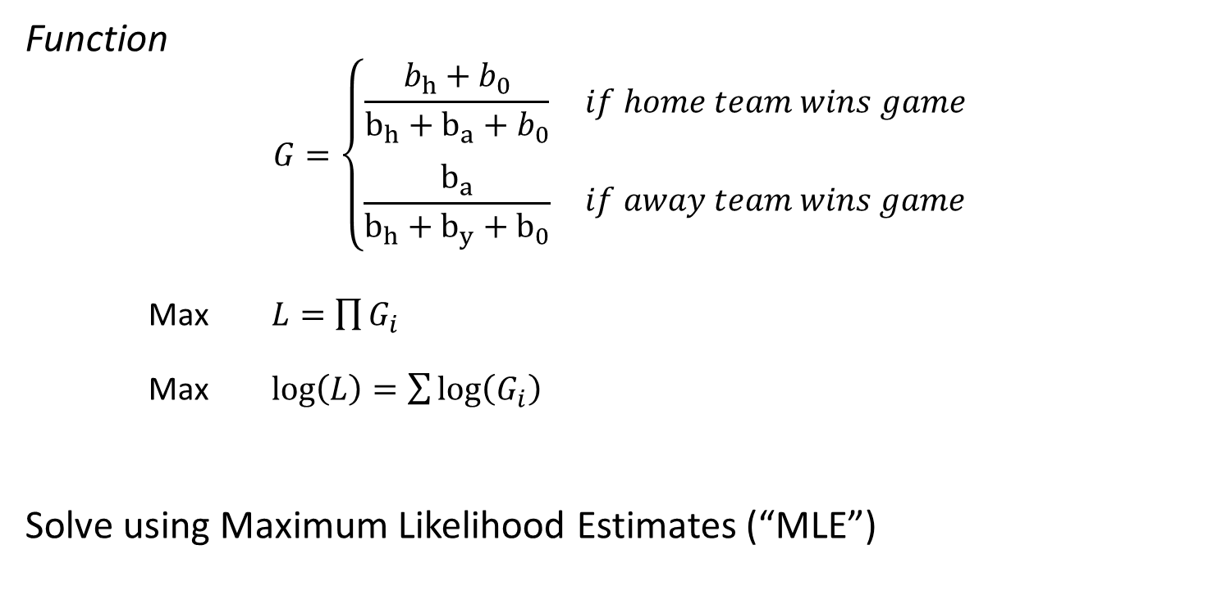
Power Function: Solving Parameters
Function
$$G=\left\{\begin{matrix}\frac{b_{h}+b_{0}}{b_{h}+b_{a}+b_{0}} & if home team wins game \\ \begin{aligned} \\ \frac{b_{a}}{b_{h}+b_{y}+b_{0}}\end{aligned} & if away team wins game\end{matrix}\right.$$
Max $L=\prod{G_{i}}$
Max $log\left(L\right)=\sum{\log\left(G_{i}\right)}$
Solve using Maximum Likelihood Estimates (“MLE”)

Slide 31
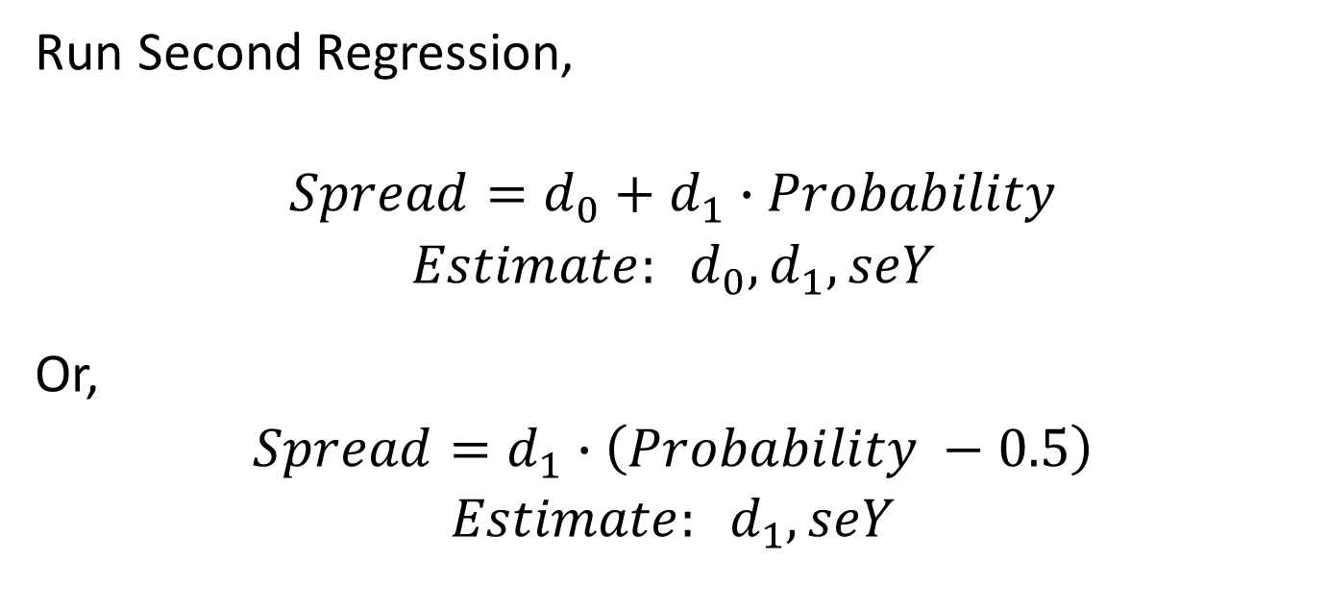
Power Function: Estimate Spread
Run Second Regression,
$$Spread=d_{0}+d_{1}∙Probability$$
$$Estimate: d_{0}, d_{1}, seY$$
Or,
$$Spread=d_{1}∙\left(Probability −0.5\right)$$
$$Estimate: d_{1}, seY$$

Slide 32
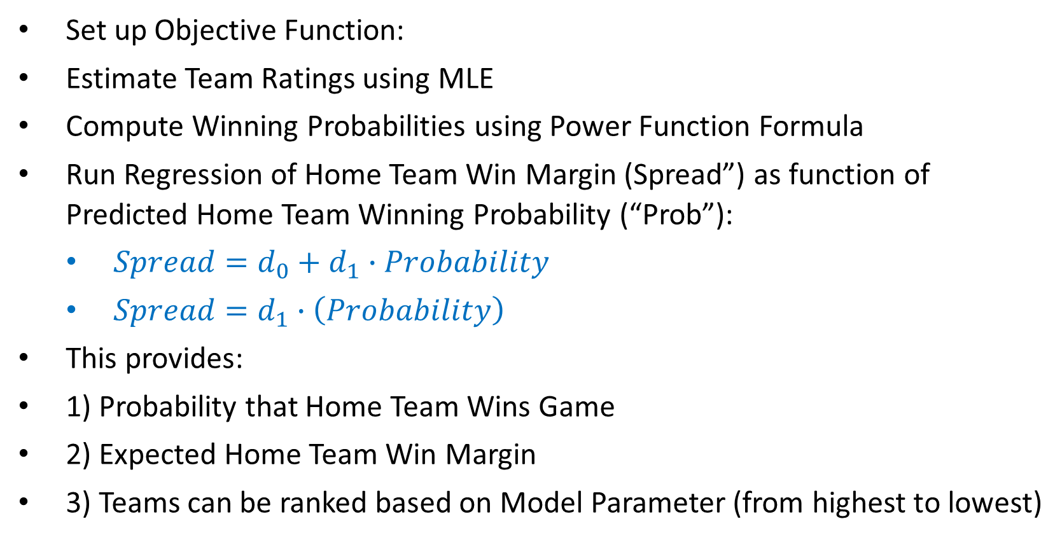
Steps to Solve Power Function
Set up Objective Function:
Estimate Team Ratings using MLE
Compute Winning Probabilities using Power Function Formula
Run Regression of Home Team Win Margin (Spread”) as function of Predicted Home Team Winning Probability (“Prob”):
$Spread={d_{0}+d}_{1}∙Probability$
$Spread=d_{1}∙\left(Probability\right)$
This provides:
1) Probability that Home Team Wins Game
2) Expected Home Team Win Margin
3) Teams can be ranked based on Model Parameter (from highest to lowest)

Slide 33
Logit Regression

Slide 34
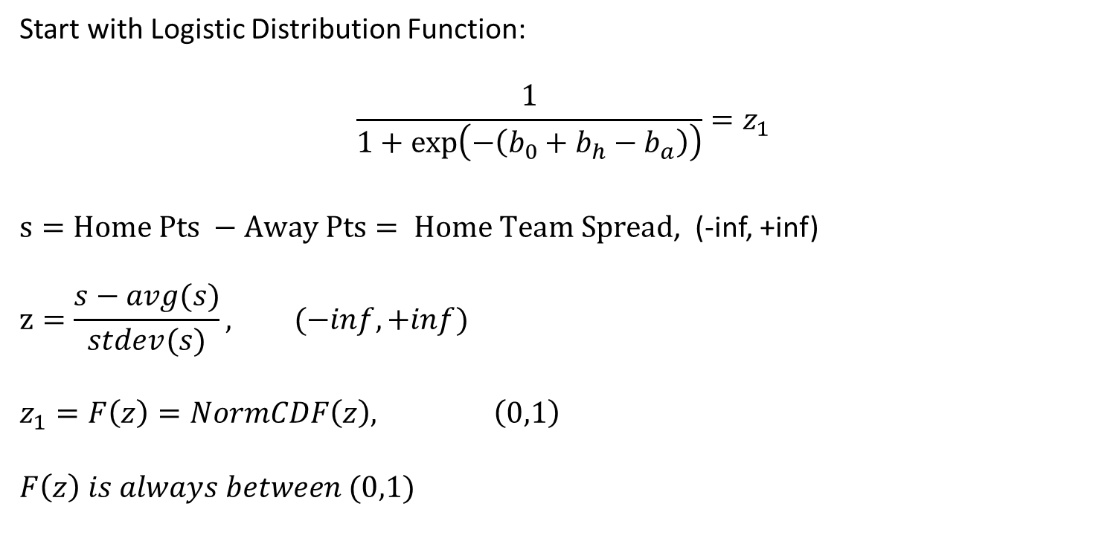
Logit Regression Model
Start with Logistic Distribution Function:
$$\frac{1}{1+\exp\left(−\left(b_{0}+b_{h}−b_{a}\right)\right)}=z_{1}$$
$s=Home Pts −Away Pts= Home Team Spread$, (-inf, +inf)
$$z=\frac{s−avg(s)}{stdev(s)}, (−inf, +inf)$$
$$z_{1}=F\left(z\right)=NormCDF\left(z\right), \left(0,1\right)$$
$$F\left(z\right) is always between (0,1)$$

Slide 35
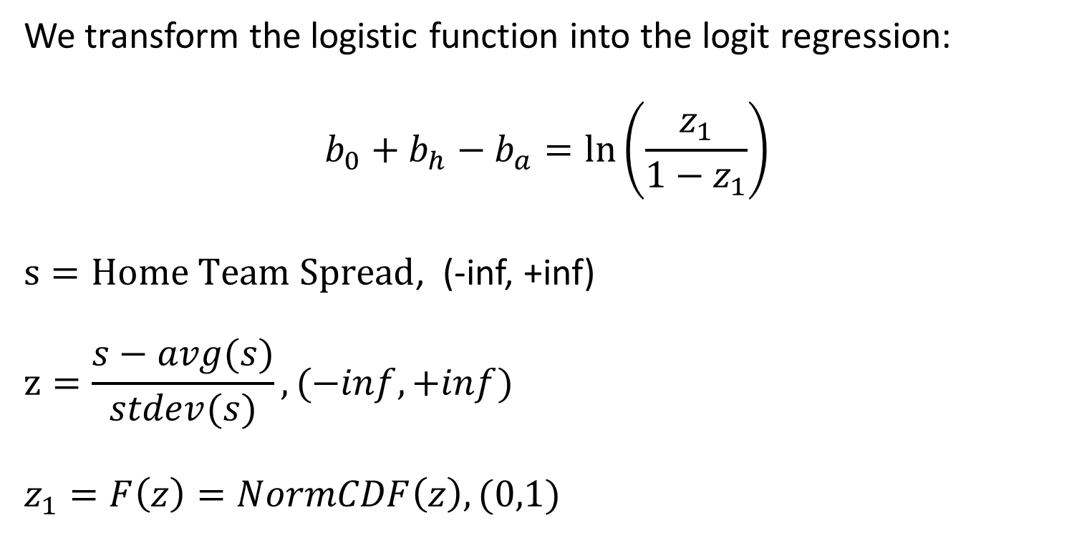
Logit Regression Model
We transform the logistic function into the logit regression:
$$b_{0}+b_{h}−b_{a}=ln\left(\frac{z_{1}}{1−z_{1}}\right)$$
$s=Home Team Spread$, (-inf, +inf)
$$z=\frac{s−avg(s)}{stdev(s)}, (−inf, +inf)$$
$$z_{1}=F\left(z\right)=NormCDF\left(z\right), (0,1)$$

Slide 36
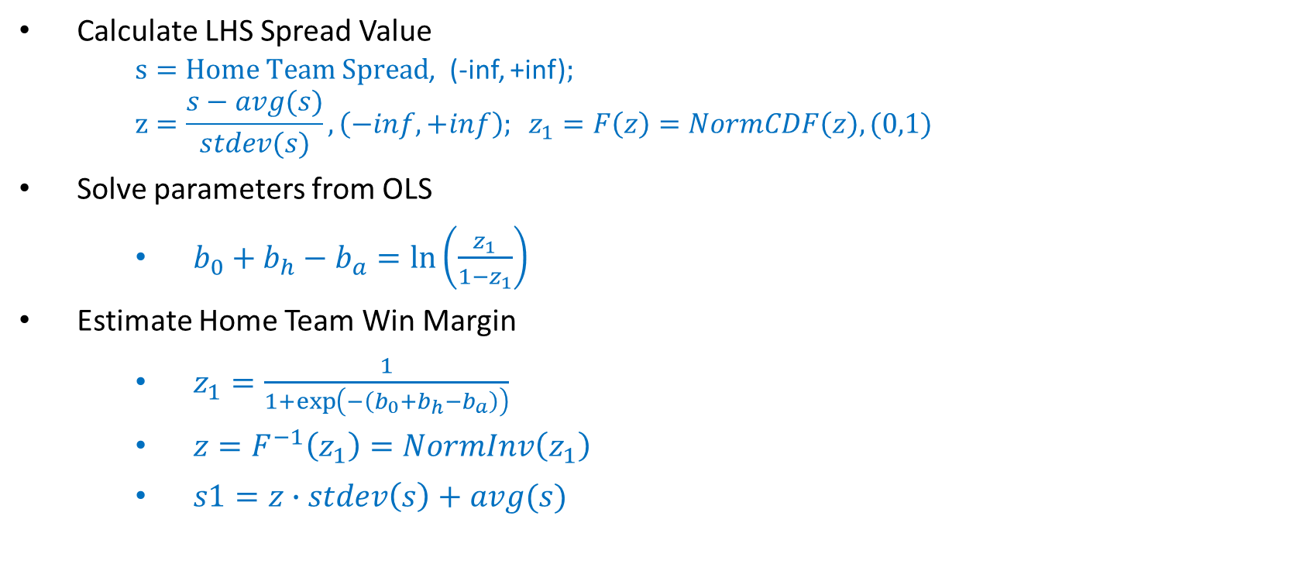
Steps to Solve Logit Spread Regression (Part 1)
Calculate LHS Spread Value
$s=Home Team Spread$, (-inf, +inf);
$$z=\frac{s−avg(s)}{stdev(s)}, \left(−inf, +inf\right); z_{1}=F\left(z\right)=NormCDF\left(z\right), (0,1)$$
Solve parameters from OLS
$b_{0}+b_{h}−b_{a}=ln\left(\frac{z_{1}}{1−z_{1}}\right)$
Estimate Home Team Win Margin
$z_{1}=\frac{1}{1+\exp\left(−\left(b_{0}+b_{h}−b_{a}\right)\right)}$
$z=F^{−1}\left(z_{1}\right)=NormInv\left(z_{1}\right)$
$s1=z∙stdev\left(s\right)+avg(s)$

Slide 37

Steps to Solve Logit Spread Regression (Part 2)
Run second regression:
$Actual Spread={d_{0}+d}_{1}∙s1$
$Estimate: {d_{0}, d}_{1}, seY$
Adjusted Spread Estimate:
$s={d_{0}+d}_{1}∙s1$
Compute Home Team Win Probability
$Prob\left(s\right)>0$
$Prob\left(s\right)>0=1−NormCDF(0,s,seY)$

Slide 38
NFL Examples

Slide 39
Excel Examples
Excel Spreadsheet: Excel_Lec03_Data.xlsx
Model Examples:
Power Function
Logistic Function
Logit Model

Slide 40
AlgoSports23/MATLAB Competition

